Slide 1
Solutioning Part 1 & 2 Report!

Slide 2
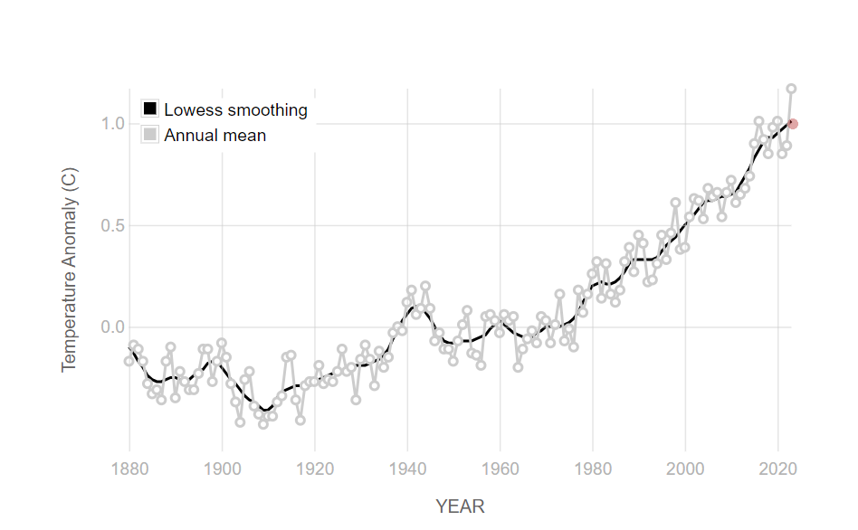

Introduction
Choice of dataset: Image data of Natural Scenes around the world.
Problem Statement: My research involves analyzing a dataset that tracks changes in various aspects of the environment, such as sea levels, mountains, forests, glaciers, buildings, and streets. My aim is to comprehend the broad range of impacts caused by global warming, including rising sea levels, deforestation, and temperature shifts in mountainous and urban areas. By gaining insight into these changes, we aim to contribute valuable information for monitoring climate change and developing effective strategies to mitigate its effects.

Slide 3

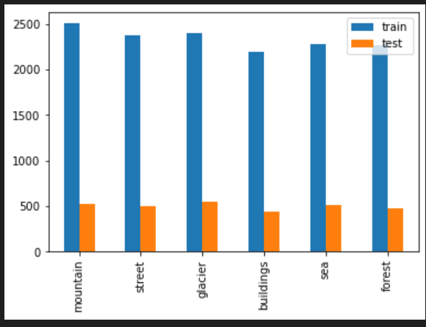
Date Loading & Exploration
Data Loading
- Loaded the dataset consisting of six classes: street, glacier, buildings, sea and forest
- Leveraged OpenCV and os libraries to read, resize, orgainze and shuffle the image jjjjdata
Data Exploration
- Explored the dataset to understand its strucutre and characteristics
- Checked the number of training and testing examples available
- Checked on the size of the images to gain insights on the data format
- Visualized the distribution of training and testing data among the six classes through bar chart and pie chart

Slide 4
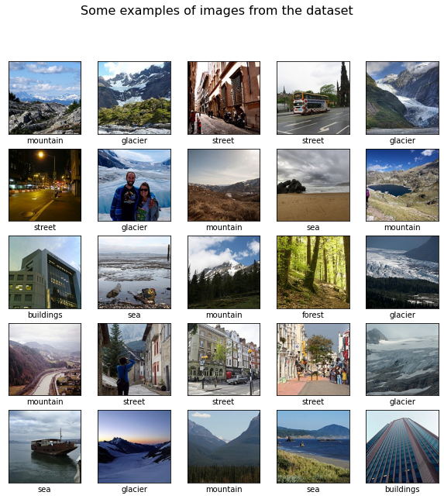
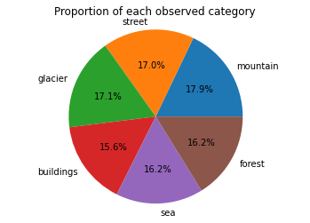
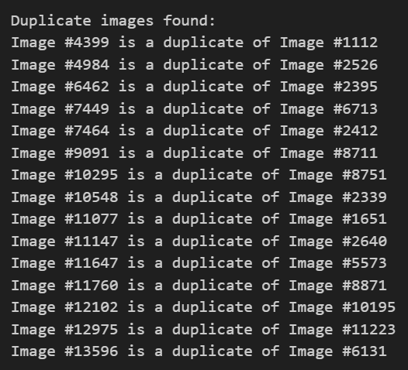
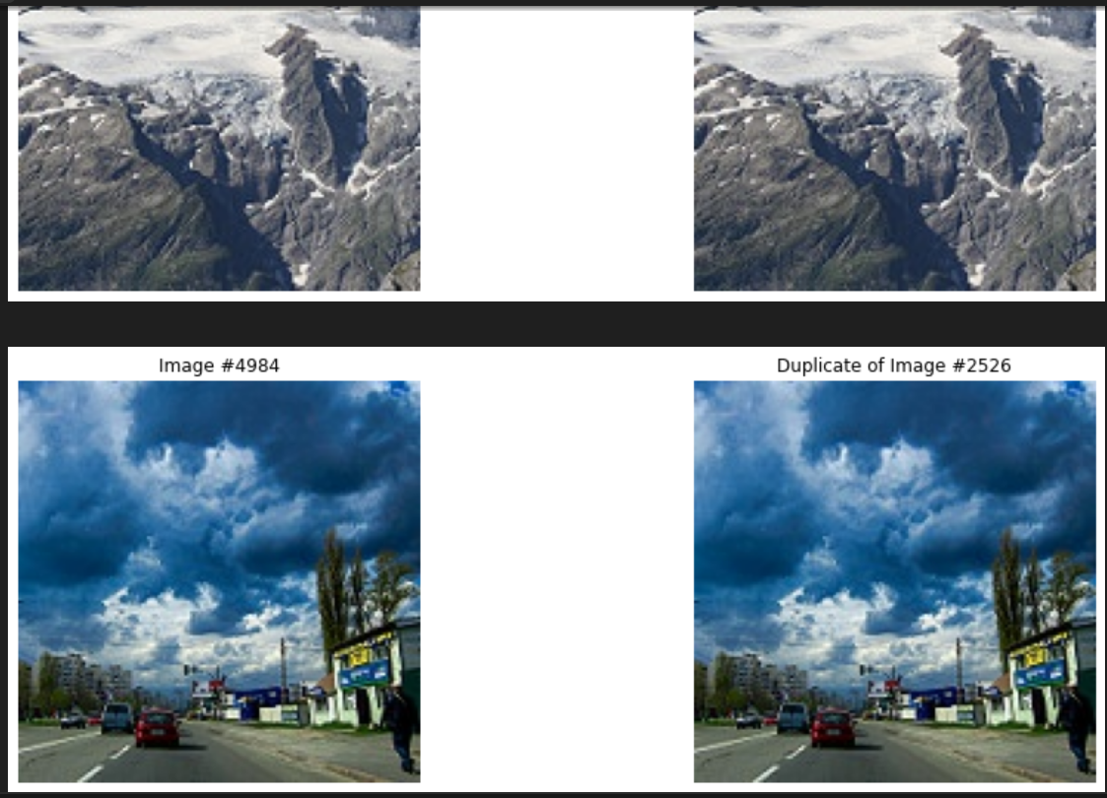
Date Exploration
- Accessed whether each class had a balanced representation (No class imbalance)
- Visualized sample images from various classes to get a qualitative understanding
- Checked for duplicate images using a function
- Displayed original and duplicate images to confirm they are really duplicates
- Removed duplicates to maintain data integrity and avoid bias

Slide 5

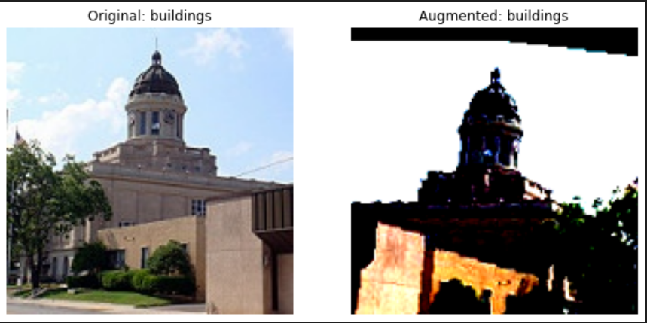
Data Pre-Processing
Data Augmentation
Scaled the data
- Implemented data augmentation techniques using PyTorch transforms
- Included resizing, color jitter, random flips, rotations, affine transformations, and cropping.
- Convered the list of images to numPy array
- Normalized pixel values in training data
Normalization
- Used scikit-learn's MinMaxScaler for efficient pixel value normalization.
Notes:
Scaling:
Scaling typically refers to bringing all feature values within a similar range. It ensures that the features have the same scale, which can prevent some features from dominating others in the model training process.
Common scaling techniques include min-max scaling (also known as normalization), standardization (subtracting the mean and dividing by the standard deviation), and robust scaling (scaling features to median and interquartile range).
Scaling is useful for algorithms that use distance-based metrics or regularization, such as k-nearest neighbors (KNN) and support vector machines (SVMs).
Normalization:
Normalization often specifically refers to rescaling the features to have a mean of 0 and a standard deviation of 1 (also known as standard normalization). It centers the data around 0 and scales it to have a unit variance.
Normalization is useful when the features have different scales and distributions. It ensures that each feature contributes equally to the model fitting process.
In addition to standard normalization, other normalization techniques include L1 normalization (scaling features such that the sum of absolute values is 1) and L2 normalization (scaling features such that the sum of squares is 1).

Slide 6
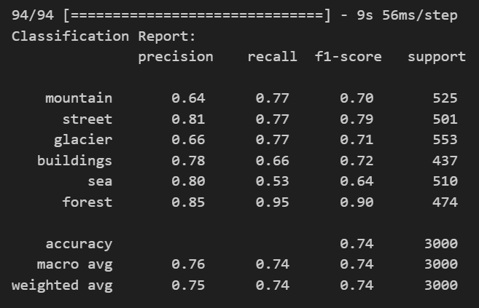
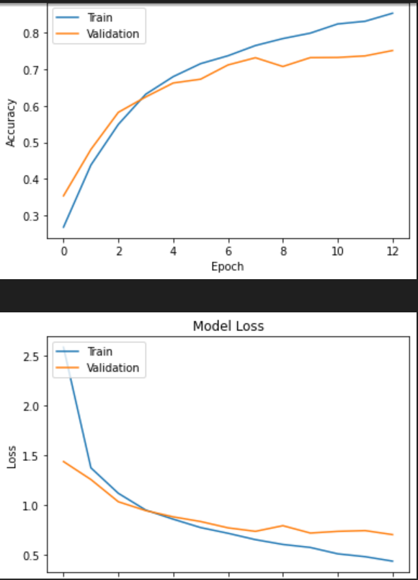
Modelling (Baseline)
- Created a baseline model to predict the class labels. Used a Lenet 5 model
- Compiled the model with the Adam optimizer & sparse categorical crossentropy loss.
- Trained the model on the preprocessed and augmented data.
- Monitored training accuracy, validation accuracy, and loss during epochs.
- Plotted training & validation accuracy and loss values
- Assessed the model's performance using accuracy metrics.
- Use additional metrics like precision, recall and F1 score for more in depth understanding. (Classification report)

Slide 7
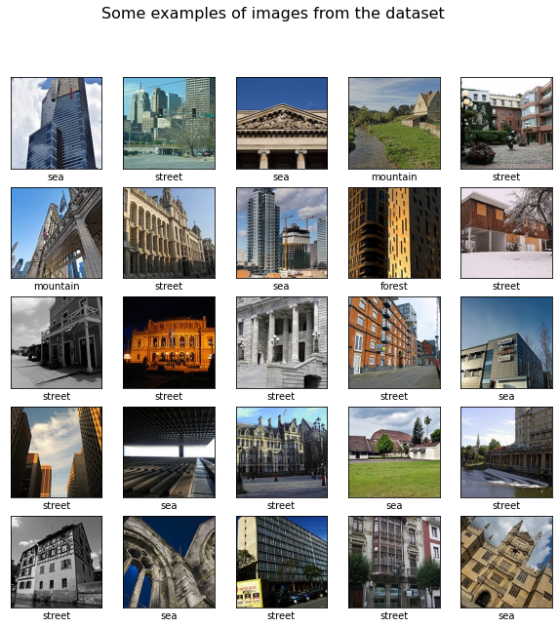
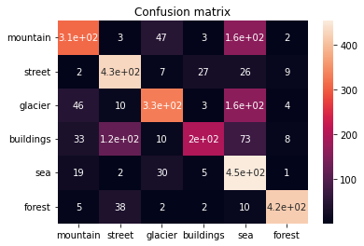
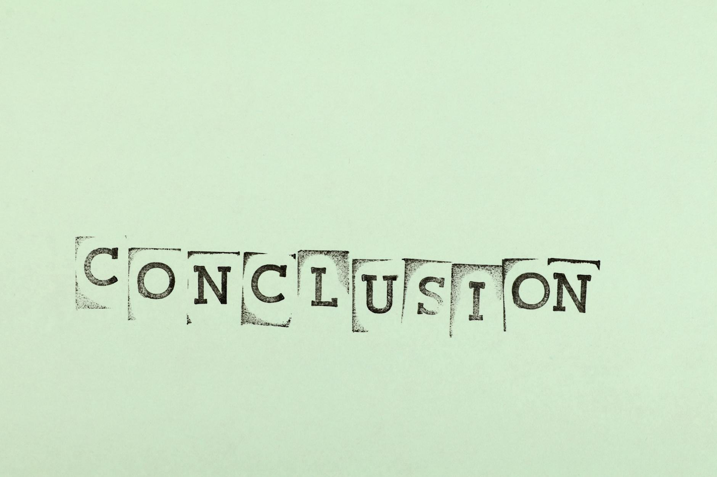
Error Analysis
Mislabelled Images
Confusion Matrix
Conclusion
- Printed 25 examples of mislabeled images by the classifier
- Happens when test_labels != pred_labels
- Examined the confusion matrix to identify which classes are being misclassified more.
- The classifier has trouble with street and buildings.
- It has also trouble with sea, glacier and mountain as well.

Slide 8
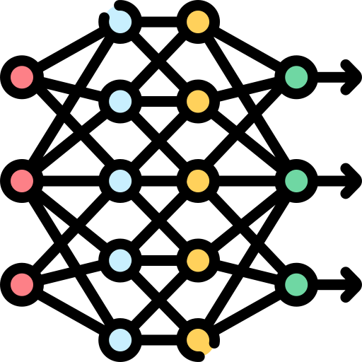
Additional Models
1. VGG16
Description: VGG16 is a convolutional neural network architecture with 16 layers, known for its simplicity and effectiveness in image classification tasks.
2. ResNet
Description: ResNet (Residual Neural Network) is a deep learning model architecture known for its effectiveness in training very deep neural networks.
3. Custom CNN
Description: Custom CNN is a convolutional neural network architecture designed from scratch for the specific image classification task.

Slide 9
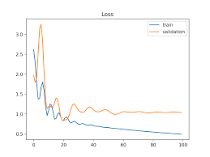
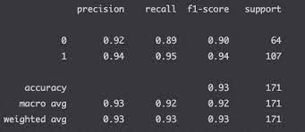
Evaluation & Analysis
1. Fine-tuning Hyperparameters:
- Experimented with various hyperparameters including learning rates, batch sizes, and optimizer settings for each model.
- Adjusted hyperparameters based on the observed performance on validation datasets to prevent overfitting and improve generalization.
2. Evaluation Metrics:
- Evaluated each model's performance using multiple evaluation metrics such as accuracy, precision, recall, and F1-score through classification report.
- Analyzed learning curves to understand the convergence behavior and identify potential issues like overfitting or underfitting.

Slide 10


Evaluation & Analysis
3. Deep Analysis of Model Performance:
- Reviewed classification reports to assess the model's ability to correctly classify each class and identify any class imbalances or biases.
- Analyzed confusion matrices to understand where the models are making errors and identify common patterns or trends.
4. Model Architectures and Hyperparameters:
- Explored different architectures, including variations in the number of layers, filter sizes, and activation functions to find the most suitable configuration for each model.
- Utilized techniques like dropout, L2 regularization, and weight decay to prevent overfitting and improve model generalization.

Slide 11

Evaluation & Analysis
5. Strengths and Limitations:
- Identified the strengths and weaknesses of each model, including areas where they excel and areas where they may struggle.
- Provided recommendations for further improvement, such as exploring more complex architectures, fine-tuning hyperparameters, or collecting additional training data.
6. Conclusion and Future Work:
- Summarized the key findings and conclusions from the analysis, highlighting the best-performing models and their characteristics.
- Outlined potential areas for future research and experimentation, such as exploring advanced optimization algorithms, incorporating domain-specific knowledge, or leveraging transfer learning techniques.

Slide 12

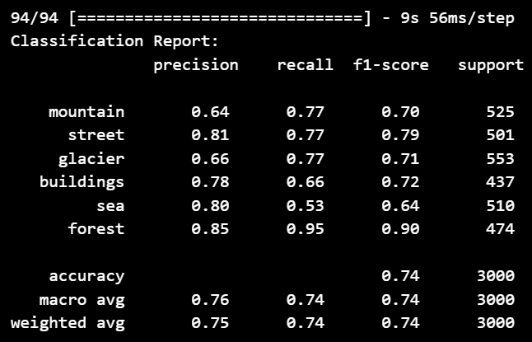
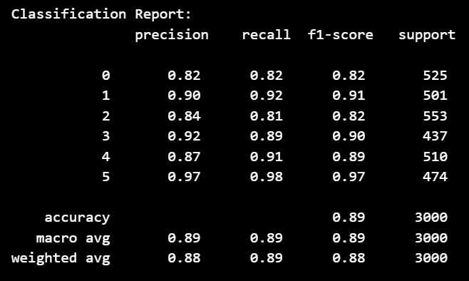
Best Model
Baseline Model
Train Accuracy: 0.8383
Validation Accuracy: 0.701
Test Accuracy: 0.7433
Best Model (VGG16)
Train Accuracy: 0.9794
Validation Accuracy: 0.8976
Test Accuracy: 0.901
Notes:
1. Analysis on the classification report:
Precision, Recall, F1-score: The model achieves high precision, recall, and F1-score for most classes, indicating that it performs well in correctly identifying instances of each class. Specifically, classes 1, 3, 4, and 5 have high precision, recall, and F1-scores above 0.90, indicating strong performance in classification.
Support: The support value indicates the number of samples in each class. It appears that the dataset is relatively balanced, with each class having a similar number of samples.
Accuracy: The overall accuracy of the model is 0.89, which indicates that it correctly classifies 89% of the samples in the test set.
Macro Avg and Weighted Avg: Both macro and weighted averages for precision, recall, and F1-score are around 0.89, indicating consistent performance across different classes.
Strengths: The model demonstrates strong classification performance across all classes, with high precision, recall, and F1-scores. It achieves particularly high scores for classes 1, 3, 4, and 5.

Slide 13

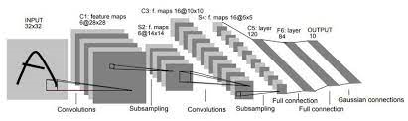
Conclusion
1. Model Selection
Choosing the appropriate model architecture is crucial for achieving high performance. If given more time, I would have thoroughly researched and experimented with various architectures, considering factors such as depth, width, and complexity, to identify the most suitable model for the given task.
2. Hyper-Parameter Tuning
Fine-tuning hyperparameters such as learning rate, batch size, and optimizer settings can significantly impact model performance. With more time, I would have conducted systematic hyperparameter optimization using techniques like grid search or random search to find the optimal combination of hyperparameters.

Slide 14
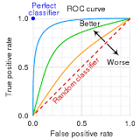


Conclusion
3. Evaluation Metrics
It's essential to use appropriate evaluation metrics that reflect the task's objectives and characteristics. I would have considered metrics beyond accuracy, such as precision, recall and F1-score, to gain a more comprehensive understanding of model performance. (e.g. ROC curve)
4. In conclusion,
With additional time, I would have focused on comprehensive model exploration, hyperparameter tuning, regularization, and thorough evaluation to develop a robust and high-performing model.

Slide 15
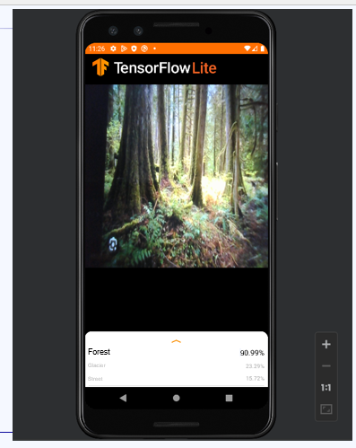
Android Deployment

Slide 16

Thank You!!!

Slide 17
Resources
https://www.analyticsvidhya.com/blog/2020/02/learn-image-classification-cnn-convolutional-neural-networks-3-datasets/
https://www.kaggle.com/code/arbazkhan971/image-classification-using-cnn-94-accuracy

